Slide 1

Minivalve
Gerrald Boskers
Bart Grootte Bromhaar
Rik Sluiter
Quinten Warmink

Slide 2
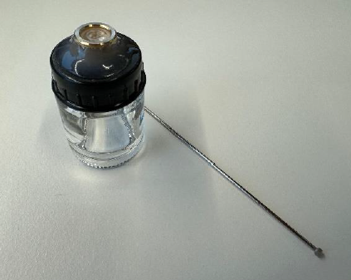
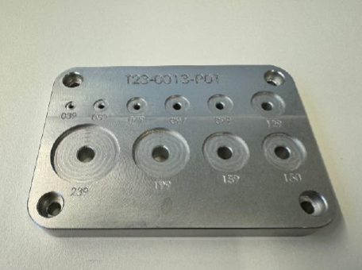
The project description
Automatization of the valve lubrication process
Solutions

Slide 3
Functions
Storage
Seeing Valves
Moving Valves
Offering Valves
Mechanism
Tool
Mechanism Needle
Lubricate Needle
Lubricate Valve
Secure Valve
Storing Valve
Feeding valve
Picking up valve
Lubricate valve
Dispose valve

Slide 4
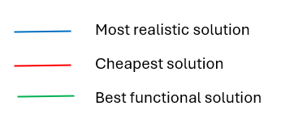
Morfological overview

Slide 8
concepts

Slide 9
The next steps
Testing
Creating 3D-model

Slide 10
Thanks

